Slide 1
A Programmer: is DRY
Python Programming

Slide 2
DRY
Design a machine to make the coffee

Slide 3
Specification
Requirements:
Different drink-types
e.g. Americano, Mocca, Espresso, Tea, Hot Choc
Take cash payment
and give change
Manage internal ingredient-hoppers
Request refills
Record transactions
Write to a file
Save and retrieve machine-state
Polite user interface
Via buttons or web-app

Slide 4
Diagrams
UML
Flow / Sequence
State
Component
Share ideas and expertise
Upload docs to git

Slide 5
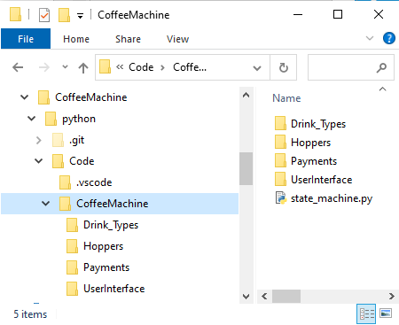
Folders for Components
Component
Create a folder for each of your components
(including one for the whole coffee-machine)

